Slide 1
Probe Data Analysis
Group Members
Daksh Gupta - A20351161
Sandeep Baradi - A20352613
Ashwani Panwar - A20384632
Hatim Dhuliawala - A20351495

Slide 2
Approach
The error region is defined as a rectangle in this study. The size of the error rectangle is based on the error analyzing of the GPS positioning data.
Find the links touched by the error region of each positioning data
Constructing the candidate link set by filtering the pseudo link set.
Filtering the candidate link pair for every probe point link set by using 4 level depth of Graph .
Used 10 instances to generate the map-match data.
Taking Tan inverse of all slope data.
Calculated the difference of average slope for probe data and average slope for link data.

Slide 3
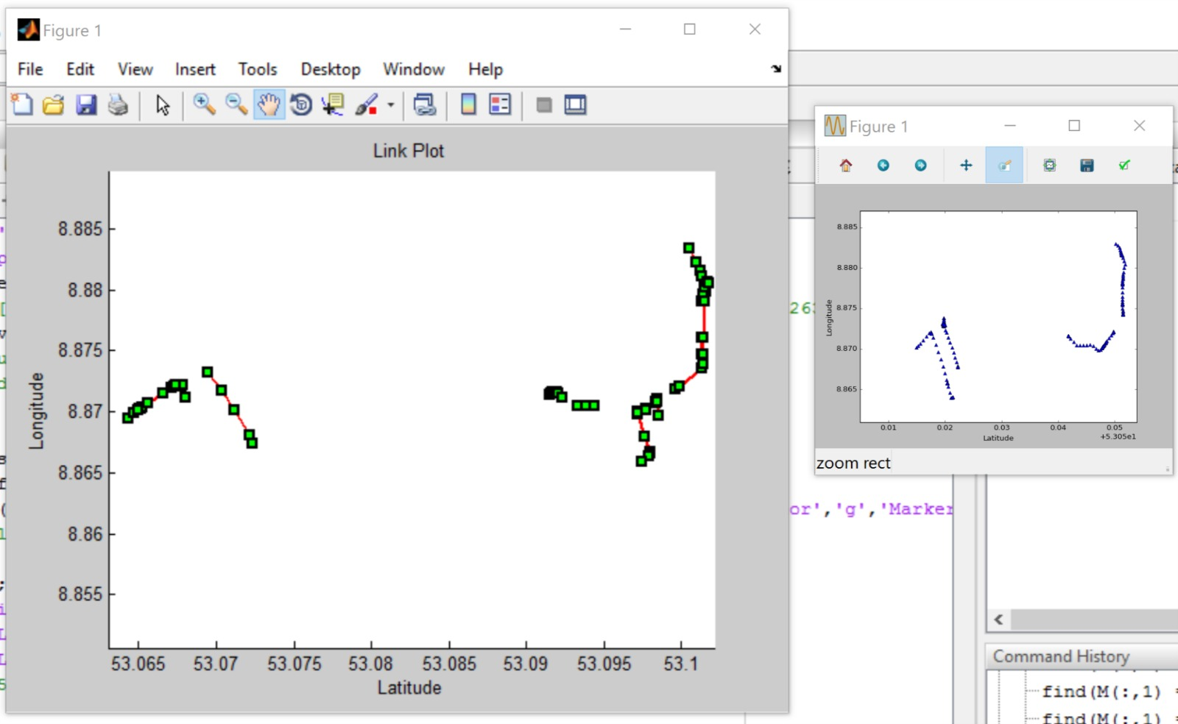
Output
Map-matching Result

Slide 4
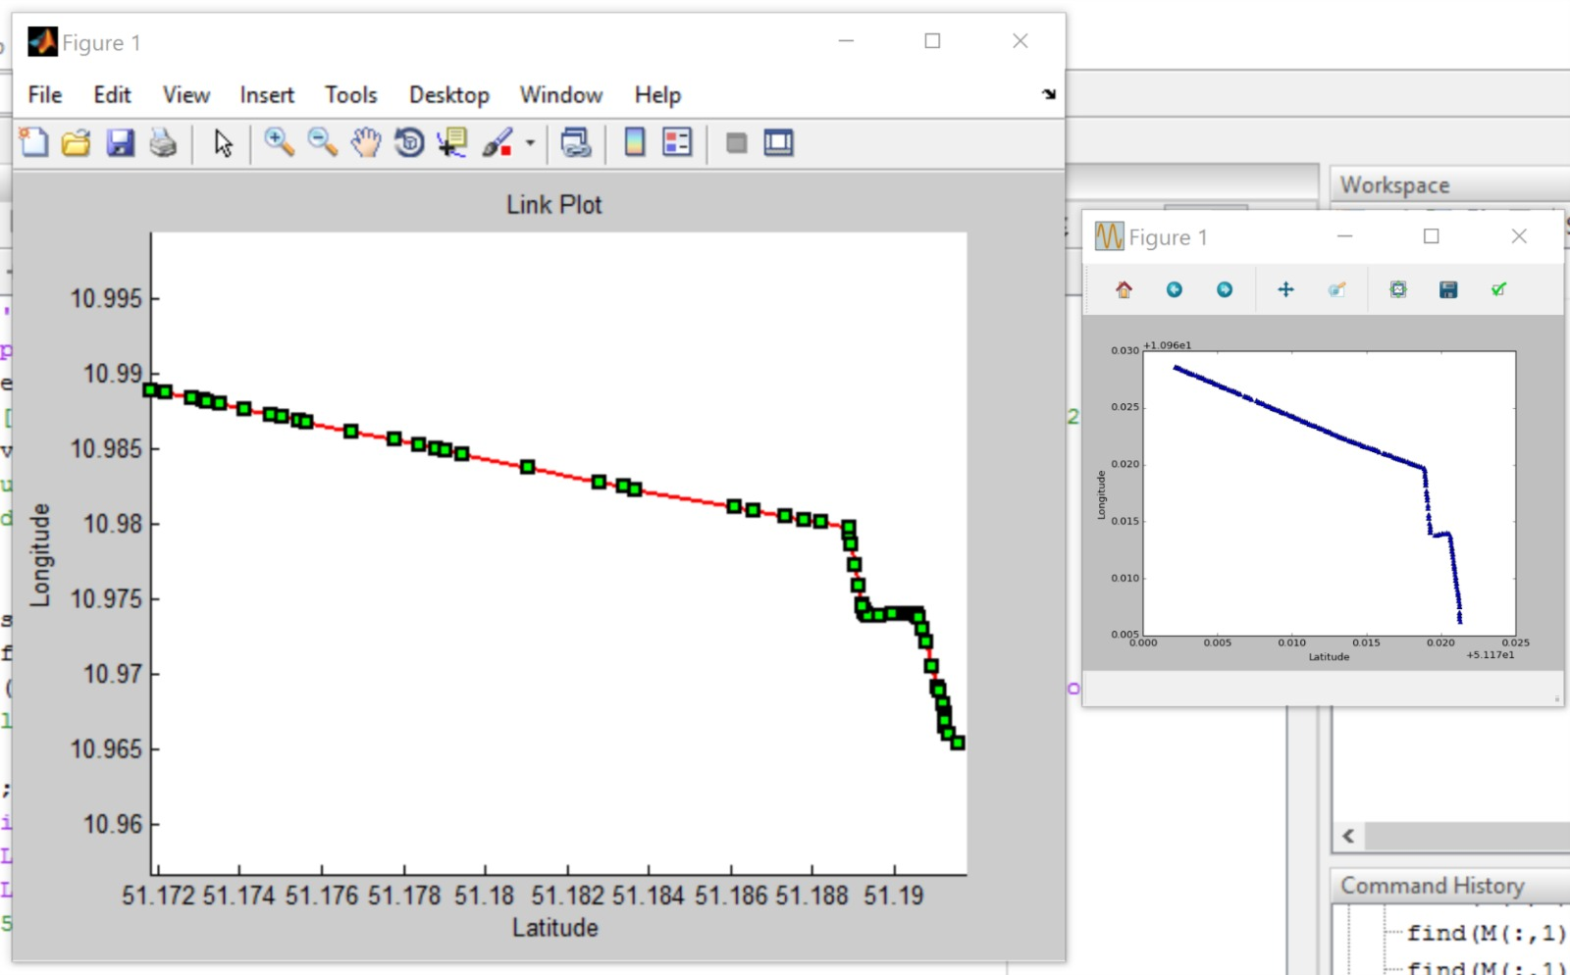

Slide 5
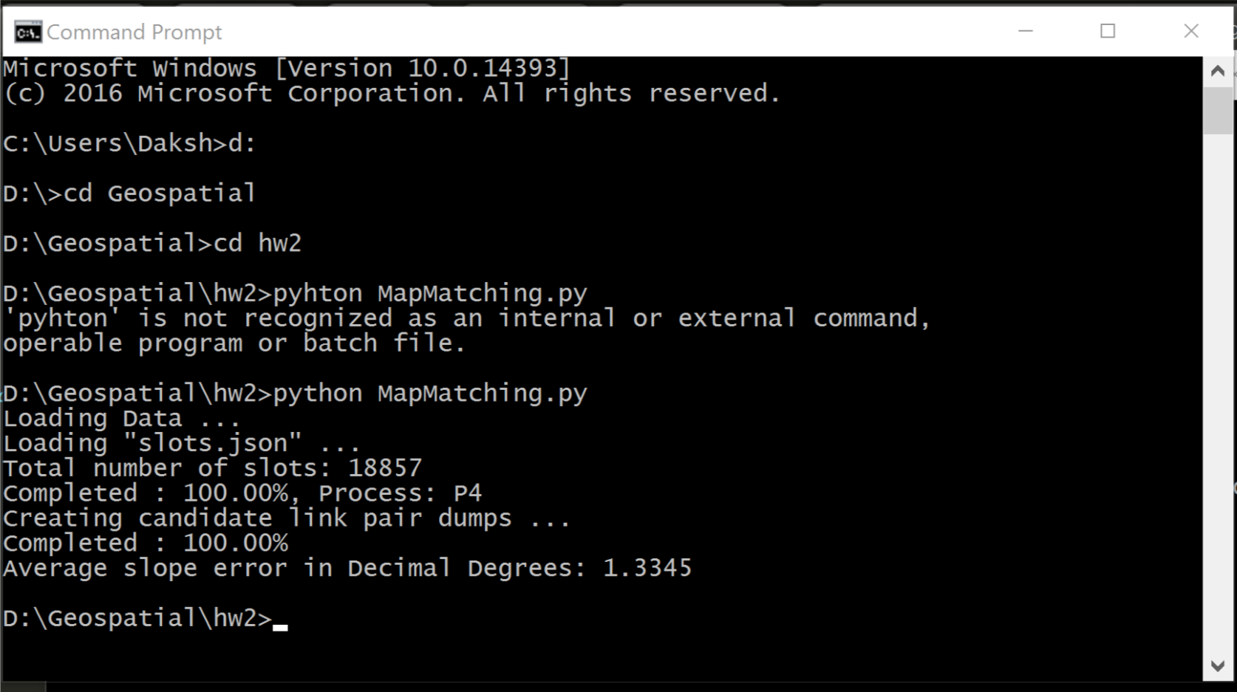
Output
Here’s our console output:
Our average slope error was calculated at 1.3345 Degrees for the Map-
Matched probe data

